Slide 1
XAI for classification of multivariate timeseries
Model XCM on ‘NATOPS’ with global and local XAI approaches
Visual Analytics
Dozent: Dominik Raab

Slide 2
Agenda
Definition of multivariate timeseries
Dataset ‘NATOPS‘
Model XCM
Architecture
Grad-CAM
Classification result
Approach
Live Demo
Conclusion

Slide 3
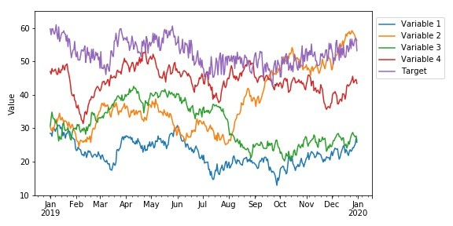
Multivariate timeseries
Eine multivariate Zeitreihe M ist eine t x l Matrix.
Jedes Element in M ist eine univariate Zeitreihe (m_{i}). Bei einem bestimmten Zeitpunkt t ist m_{t} = m₁t, m₂t, ..., m_{l}t, wobei l die Anzahl der univariaten Zeitreihen in M ist [1].
[2]

Slide 4
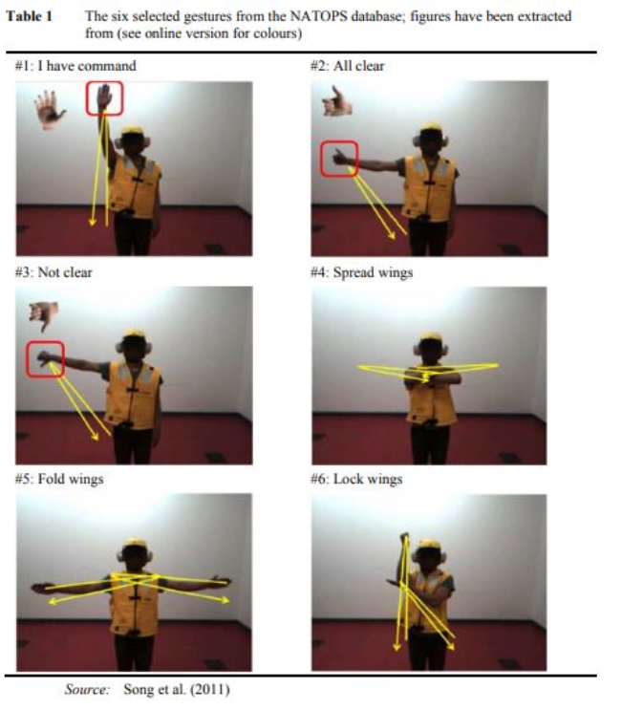
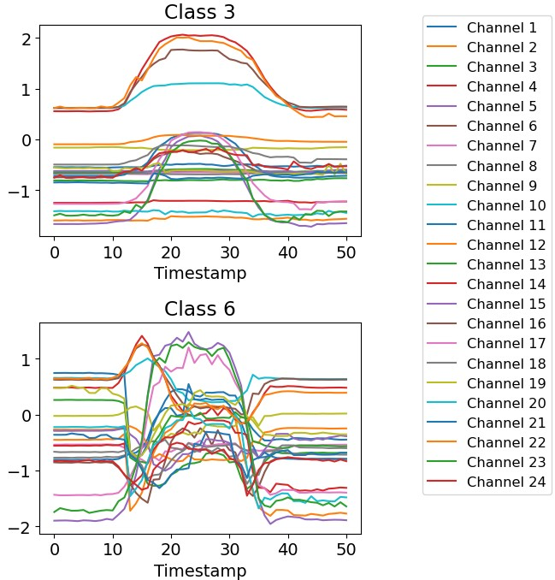
Dataset NATOPS
[3]

Slide 5
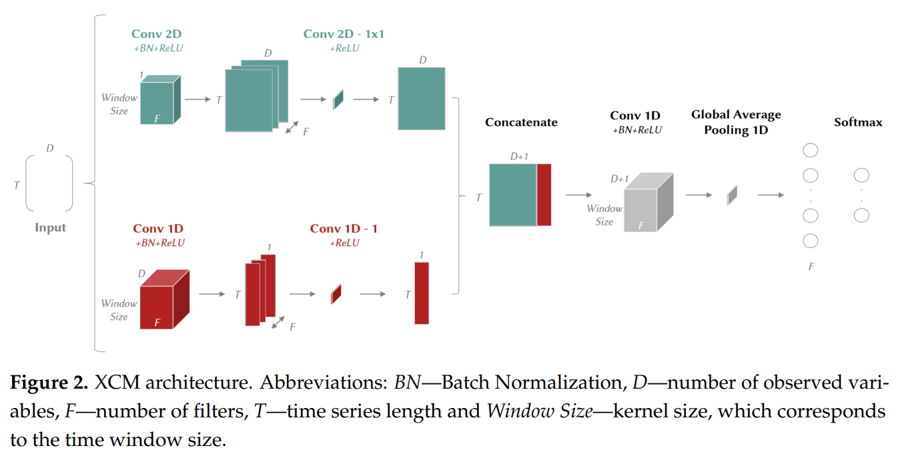
Model XCM
Extracts features directly from the observed values from the 2D convolutional filter and from time (1D convolutional filter) [4].
Feature maps are generated, which XCM processes into a 1D global average pooling and classifies with a SoftMax layer [4].

Slide 6
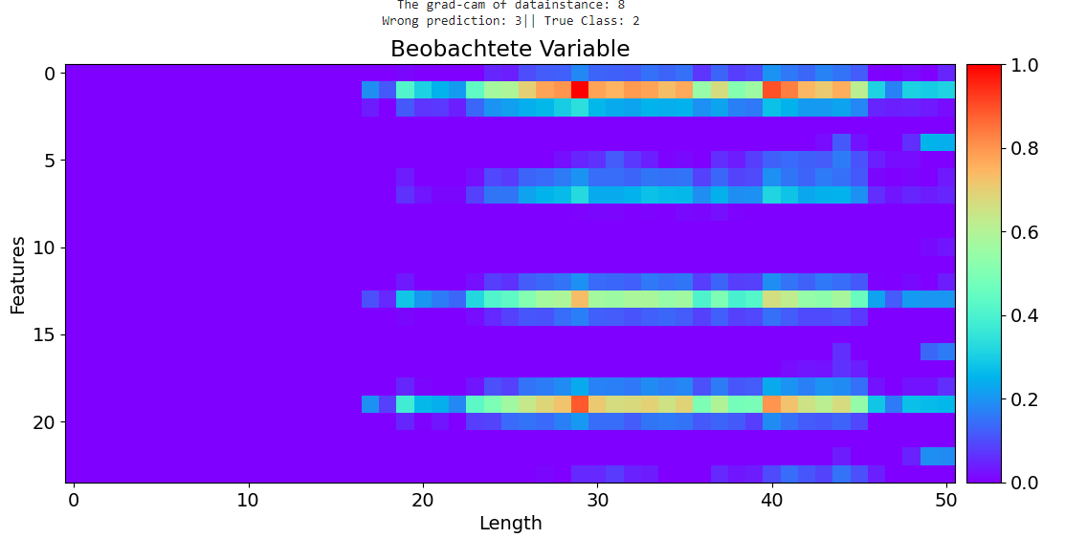
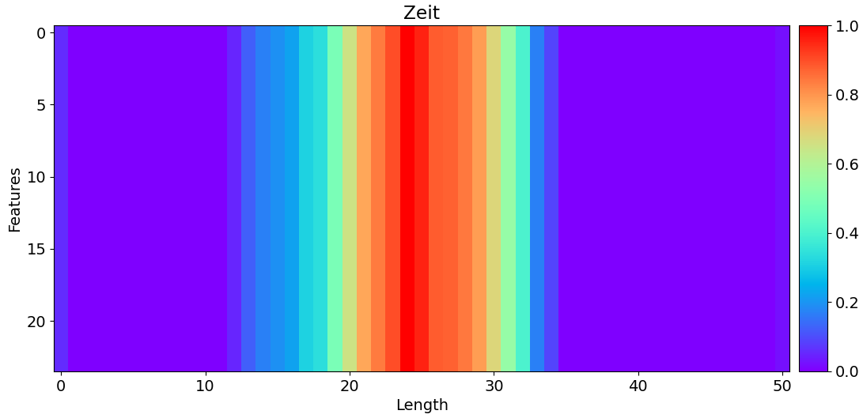
Model XCM – Grad-CAM
Grad-CAM first uses the attribution map of observed variables generated from the 2D convolutional layer feature maps [4, 7].
And second the attribution map of the time from the 1D convolutional layer [4].

Slide 7
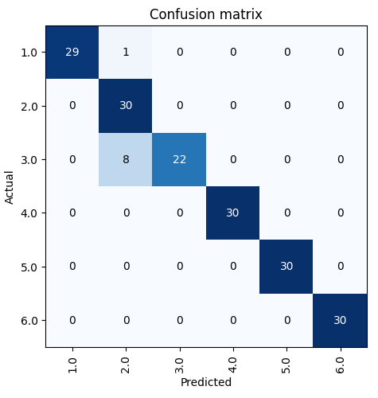
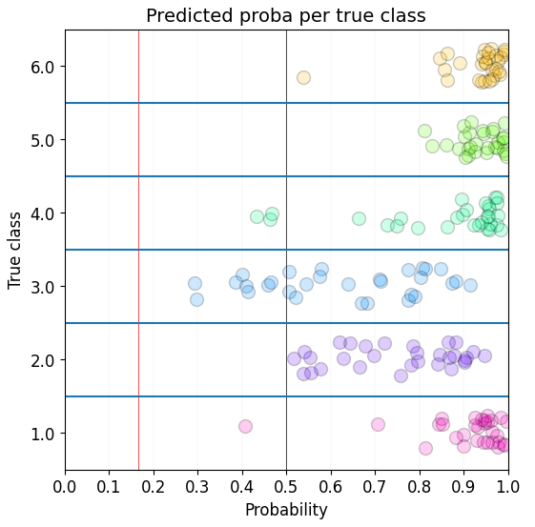
Classification Results

Slide 8
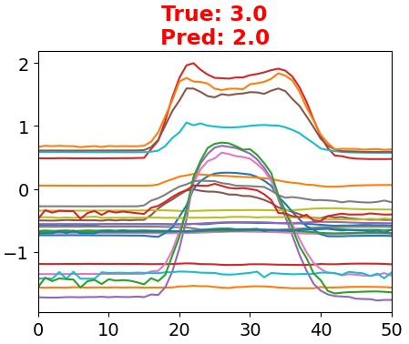
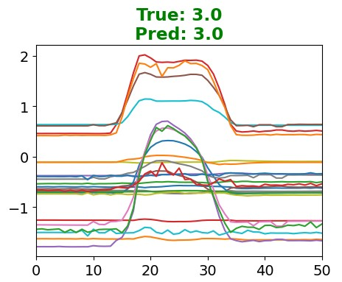
Approach
Global Explaination
(Permutation) [5,6,8]
?
Lokal Explaination
(Grad-CAM) [4]

Slide 9
Live Demo

Slide 10
Conclusion
Permutation (global)
Grad-CAM (local)
Pros
Importance of single features
Validation of robustness
Pros
Visualisation of activiation maps in interpretable heatmaps
Simple Implementation
Cons
High dimensionality makes permutation insufficient
Computational intensity
Cons
Special regions without global context
Sometimes difficulties to distribute special attributes or pixel

Slide 11
Referenzen
[1] H. Ismail Fawaz, G. Forestier, J. Weber, L. Idoumghar, and P.-A. Muller, “Deep learning for time series classification: a review,” Data Mining and Knowledge Discovery, vol. 33, no. 4, pp. 917–963, 2019.
[2] https://media.licdn.com/dms/image/C4D12AQEcogkLzyEYNQ/article-inline_image-shrink_400_744/0/1576516447396?e=1692230400&v=beta&t=iERYcUJCz6g0EHO4OtKzwf9_WzmNwmonX7mBR9AF8PU
[3] http://www.timeseriesclassification.com/description.php?Dataset=NATOPS
[4] K. Fauvel, T. Lin, V. Masson, É. Fromont, and A. Termier, “Xcm: An explainable convolutional neural network for multivariate time series classification,” Mathematics, vol. 9, no. 23, p. 3137, 2021.
[5] https://github.com/timeseriesAI/tsai
[6] https://github.com/fastai/fastai
[7] R. R. Selvaraju, M. Cogswell, A. Das, R. Vedantam, D. Parikh and D. Batra, "Grad-CAM: Visual Explanations from Deep Networks via Gradient-Based Localization," 2017 IEEE International Conference on Computer Vision (ICCV), Venice, Italy, 2017, pp. 618-626, doi: 10.1109/ICCV.2017.74.
[8] Fisher, Aaron, Cynthia Rudin, and Francesca Dominici. “All models are wrong, but many are useful: Learning a variable’s importance by studying an entire class of prediction models simultaneously.” http://arxiv.org/abs/1801.01489 (2018)

